Slide 1
Control Structure/ Iterative /Repetition Structure
By: Nida Munawar

Slide 2
Control statements
Break
Continue
goto

Slide 3
Break statement
The break statement, when executed in a while, for, do…while or switch statement, causes an immediate exit from that statement. Program execution continues with the next statement.
The break statement is typically used for two purposes:
To exit early from a loop
To skip the remainder of the switch structure

Slide 4
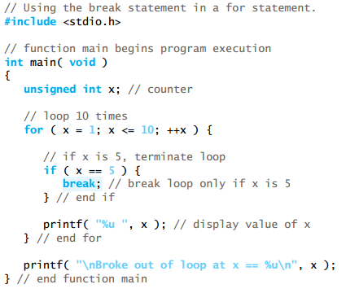
Break statement

Slide 5
Continue statement
The continue statement, when executed in a while, for or do…while statement, skips the remaining statements in the body of that control statement and performs the next iteration of the loop.
In while and do…while statements, the loop-continuation test is evaluated immediately after the continue statement is executed. In the for statement, the increment expression is executed, then the loop-continuation test is evaluated.

Slide 6
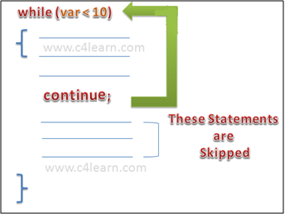
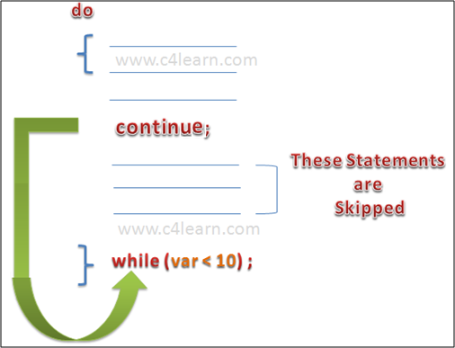
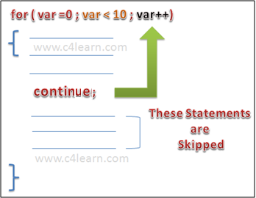
Continue statement

Slide 7
continue statement inside for loop
#include <stdio.h>
int main(){
for (int j=0; j<=8; j++){
if (j==4){
continue;
}
printf("%d ", j);
}
return 0;
}

Slide 8
continue in While loop
#include <stdio.h>
int main(){
int counter=10;
while (counter >=0) {
if (counter==7) {
counter--;
continue; }
printf("%d ", counter);
counter--; }
return 0;
}

Slide 9
Output:
10 9 8 6 5 4 3 2 1 0
In this example we are using continue inside while loop. When using while or do-while loop you need to place an increment or decrement statement just above the continue so that the counter value is changed for the next iteration. For example,
if we do not place counter– statement in the body of “if” then the value of counter would remain 7 indefinitely.

Slide 10
continue in do-While loop
#include <stdio.h>
int main(){
int j=0;
do {
if (j==7) {
j++;
continue; }
printf("%d ", j);
j++;
}while(j<10);
return 0;
}

Slide 11
What is the output
#include <stdio.h>
int main(){
int j=0;
do{
if (j==7) {
continue;
}
printf("%d ", j);
j++;
}while(j<10);
return 0;
}

Slide 12
Output
0 1 2 3 4 5 6 _ infinite

Slide 13
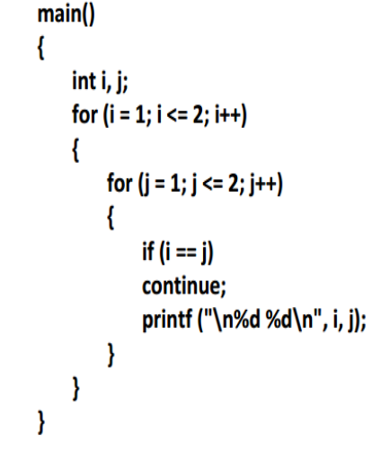
Continue statement

Slide 14
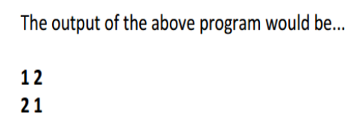
Continue statement

Slide 15
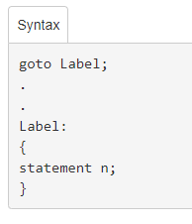
goto statement
C programming introduces a goto statement by which you can jump directly to a line of code within the same file.
The goto statement does not require any condition.
The goto statement simply passes control anywhere in a program without testing any condition.

Slide 16
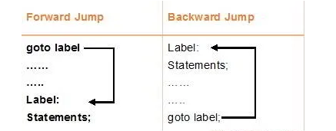
The goto statement is rarely used because it makes program confusing, less readable and complex. Also, when this is used, the control of the program won’t be easy to trace, hence it makes testing and debugging difficult.
goto can jumps in backward and forward direction

Slide 17
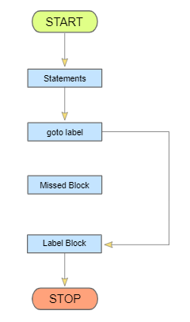
goto statement

Slide 18
#include <stdio.h>
int main(){
int sum=0;
for(int i = 0; i<=10; i++){
sum = sum+i;
if(i==5){
goto addition;
} }
addition:
printf("%d", sum);
return 0;
}

Slide 19
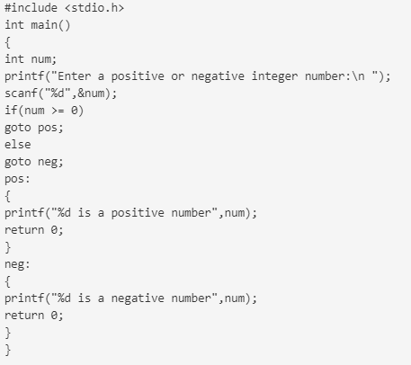
goto statement
Example: In the following program we will print whether the number is positive or negative using goto statement.

Slide 20
Nested Looping
A loop (e.g., while, do-while, for) can be placed within the body of another loop.
When one loop is nested within another, several iterations of the inner loop are performed for every single iteration of the outer loop.
The inner and outer loops need not to be generated by the same type of control structures.

Slide 21
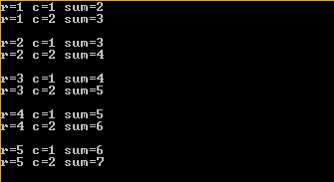
While-Nested Loop
#include<stdio.h>
int main()
{
int r,c,s;
r=1;
while(r<=5) /*outer loop*/
{
c=1;
while(c<=2) /*inner loop*/
{
s=r+c;
printf("r=%d c=%d sum=%d\n",r,c,s);
c++;
}
printf("\n");
r++; }}
while (expr1)
{
:
while (expr2)
{
:
Update expr2;
}
:
update expr1;
}

Slide 22
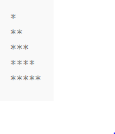
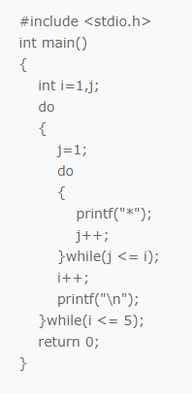
Do-while-Nested Loop
do
{
:
do
{
:
Update expr;
}
while(expr);
:
update expr;
}
while(expr);

Slide 23

For-Nested Loop
for ( expr1a; expr2a; expr3a )
{
:
for ( expr1b; expr2b; expr3b )
{
:
}
:
}
#include<stdio.h>
int main()
{
int i,j;
for (i=1; i<=5;i++) //Line 1
{
for (j=1;j<=i;j++) //Line 2
{
printf("*"); //Line 3
}
printf("\n"); //Line 4
}
}

Slide 24
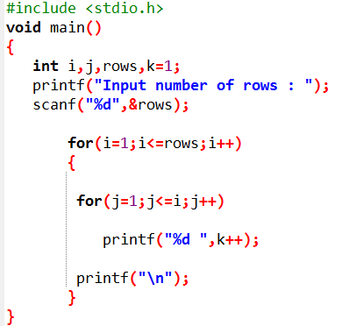
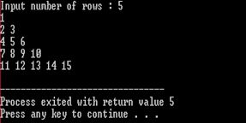
For-Nested Loop:
Example: Generate the following pattern using nested loops

Slide 25
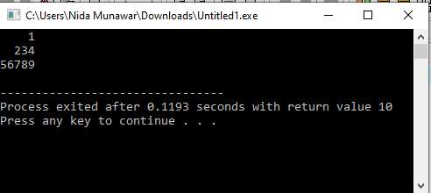
TASK:
Generate the following pattern using nested loops

Slide 26
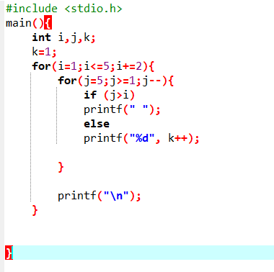

Slide 27
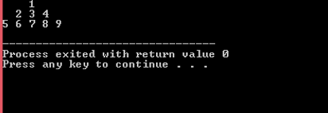
Assignment
1. Generate the following pattern using nested loops

Slide 28
Assignment
2. Write a program in C to find the sum of the series 1 +11 + 111 + 1111 + .. n terms. 3. Write a c program to check whether a given number is a perfect number or not.

